Slide 1

HSO Standards
Health Standards Organization
August 2017

Slide 2
WHO WE ARE
Years as Canada’s only national health standard and accreditation body serving every part of health care system
Health Service Provider clients, including health regions, governments
Jurisdictions on 5 continents that are using standards & assessment programs we developed
Health and social services standards in use
Leading practices awarded & in our National Data Base
60
7000
70+
130+
1000
Notes:
Health Standards Organization (HSO) and Accreditation Canada (AC) are two organizations working side-by-side to change the way health care standards are created, and the way accreditation services are provided. United under a single leadership, we are working on a global scale to help people in their local jurisdictions save and improve lives.
Our dedicated staff draw on 60 years worth of experience and lessons-learned. We assist more than 7000 health and social service providers across sectors in achieving quality health services for all, with more than 100 health and social services standards in use, and a national database of 1000 leading practices. We are independent but affiliated not-for-profit charities headquartered in Ottawa, working in more than 50 jurisdictions around the world.
HSO specializes in the development of best-in-class standards spanning the continuum of care, innovative assessment methodologies, and practical activation services and tools. Accreditation Canada plans and provides accreditation services to Canadian and international clients, helping people focus on what matters to them in their local context.

Slide 3




Who uses our standards?
Community health (e.g., treatment centres, mental health care, home care/support)
Seniors’ care (long-term care homes, retirement home, assisted living facilities)
Hospitals
Health systems (CISSS in Québec, health authorities in other provinces)
Specialty health services (e.g., labs, medical imaging centres, independent medical/surgical facilities)
Community health
Hospitals
Seniors’ care
Specialty health services
Notes:
So who exactly uses our standards? Pretty much everyone who delivers public or private health care and social services!
Our clients range from small, community-based clinics to large health care authorities.
We work with governments, regional health authorities, hospitals, and community-based programs and services in both the private and public sectors.
In Canada, with the exceptions of Québec and Manitoba, health care accreditation is largely voluntary. That means most of our clients choose to participate in our programs. It’s a mark of pride and a way to create a strong and sustainable culture of quality improvement within their walls.
As you can see from this list, we accredit:
Everyone!
Community health (e.g., treatment centres, social services, mental health, home care/support)
Seniors’ care (long-term care homes, retirement home, assisted living facilities)
Hospitals
Health systems (CISSS in Quebec, health authorities in other provinces)
Specialty health services (for example, labs, medical imaging centres, independent medical/surgical facilities)
Our roots in the Canadian health and social services run particularly deep. We work with organizations of all types and sizes, in all 13 provincial and territorial health jurisdictions and with wide-ranging population needs. This unparalleled experience gives us deep understanding and unique knowledge, which we leverage to create flexible, integrated models covering the full spectrum of health services, from large networks and health systems to small home care and primary care organizations.

Slide 4

Where are our standards used?
2015
2016
2017
2018
Notes:
We work in more than 50 jurisdictions around the world – here is a visual of the different countries using our standards
There are really two ways in which the standards are used: either as Qmentum standards, or what is called white label, where other accrediting bodies will adopt our standards and use them under their own label.
For example, we work with accrediting bodies in the Netherlands – Niaz, and in Brazil – IQG. These organizations use our standards under their own name and also accredit health care organizations against these standards
Alternatively, organizations will use the Qmentum standards and be accredited by Accreditation Canada. This is the situation in Canada, and different jurisdictions around the world where Canadian surveyors will travel to assess organizations against the standards in different jurisdictions
Examples – Brazil 64​
Ecuador​ 46​
Slovenia​ 18​
Belgium​ 8​
Italy​ 7​
Qatar 7​
Kuwait 6​
Saudi Arabia 6​
United Arab Emirates 5​
Bahrain​ 4​
Iran​ 4​
Mexico 4​
Philippines 4​
Peru​ 3​
Oman​ 2​
St.Lucia​ 2​
Angola, Bermuda, Croatia, Dominican Republic, Ecudaor, Egypt, Iran-Islamic Republic of, Slovenia, Turks and Caicos, 1​

Slide 5
Organizational Structure
HSO
ACCREDITATION CANADA
Global Programs
Corporate Services
Accreditation
Technical Committee
Technical Committee
Standards
Activation
Education Accreditation
Canadian Accreditation
International Accreditation
Technical Committee
Assessment Programs
Applications
Notes:
In February 2017, HSO was created. HSO and Accreditation Canada are affiliates, with HSO being responsible for the research and development of standards and assessment programs.
Previously, we would bring together a working group to develop standards and then disband it once the standard was published. Now we are putting into place these permanent technical committees. We have also have a team focused on assessment programs. We are now focusing on developing innovative assessment programs to meet the needs of various stakeholders.
- Will not get into too much on this today, but wanted to highlight that there is a standards team, and also an assessment team – the standards team works with the technical committees to develop standards, and the assessment team helps to design assessment programs which are then used by accrediting bodies

Slide 6


Patient Partners: in our DNA
2015
CFCC introduced throughout standards
Patient partnership office founded
2016
2017
Patient partners on technical committees
Patient surveyors methodology introduced
2018
Notes:
*****HSO-AC believes firmly in patient partnership.
Our engagement is to imply patients at every level of the health care system.
As you know, the development and revision of standards will be done in co-design with different type of expert, including patients experts. Also, we have already started to integrate patient as surveyor and we are now in recruiting to launch the project more widely.
We also have team of expert on patient partnership, one member of the team is a specialist on patient engagement in the health care system and the other member is a patient expert, patient herself.
We truly believe that co-leading with patient at every level of the health care system can bring significant improvement to the health care system.******
At HSO, we put people at the centre of everything we do. And we understand that the concept of patients as partners is part of our DNA.
We know that better results and outcomes are achieved when initiatives are conducted in partnership with patients. Through patients first-hand experiences with health care and services, we gain a tremendous amount of insight into how we can ensure every process and outcome of our work is informed, influenced, and shaped by the people for which they matter most.
Client- and family-centred care is an approach to health care that is found throughout our standards. It has become a strong point of focus for many organizations in recent years, and is based on four fundamental values:
Dignity and respect – honouring your clients’ perspectives and choices
Information sharing – sharing complete and unbiased information with your clients and their families
Partnership and participation – supporting clients and families to participate in care and decision making
Collaboration – collaborating with clients and families in policy and program

Slide 7
HSO Standards

Slide 8


STANDARDS
“HSO strives to build standards that unleash the power and potential of people around the world who share our passion for achieving quality health services for all.”
Rigorous standards development process
Recognized by ISQua
Standards Council of Canada recognition pending
Notes:
HSO has adopted a rigorous standards development process that is recognized by the United States, Canada and the European Union and also meets the principles of the International Society for Quality in Healthcare (ISQua).
HSO is also working towards becoming accredited by the Standards Council of Canada, a Canadian organization that advances standardization in Canada and is an official representative of Canada at ISO (International Organization for Standardization)- in fact we have just completed our initial assessment by Standards Council of Canada and are expecting our accreditation status in the next 2 months.

Slide 9
Cadre de la qualité
Sécurité
Services centrés sur l'usager
Milieu de travail
Efficience
Pertinence
Accessibilité
Accent sur la population
Continuité
Notes:
DIMENSION / TEXTE EXPLICATIF
Sécurité / Assurez ma sécurité
Services centrés sur le client / Collaborez avec moi et ma famille à nos soins
Milieu de travail / Prenez soin de ceux qui s’occupent de moi
Efficience / Utilisez les ressources le plus adéquatement possible
Pertinence / Faites ce qu’il faut pour atteindre les meilleurs résultats
Accessibilité / Offrez-moi des services équitables, en temps opportun
Accent sur la population / Travaillez avec ma communauté pour prévoir nos besoins et y répondre
Continuité / Coordonnez mes soins tout au long du continuum de soins

Slide 10

OVER 130 STANDARDS COVERING…
Emergency and Disaster Preparedness
Emergency Medical Services
Medication Management
Leadership & Governance
Child Welfare
Diagnostic Imaging
Infection Prevention & Control
Technology-Enabled Health Care
Stroke
Family Planning
Clinical Leadership & Patient Partnership
Care in the Community and Home
Indigenous Health
Rehabilitation
Technology-Enabled Health Care
Dental Services
Spinal Cord Injury
Acute and Surgical Care
Mental Health and Addictions
Primary Health Care
Animal and Food Safety
Communication in Health Services
Donation
Seniors Care
Intellectual and Developmental Disabilities
Palliative and End-of-Life Care
Integrated Health
+ Intervention Standards

Slide 11
HSO STANDARDS – CLASS AND SERIES
CLASS
SERIES
Integrated Health Services
Health Service Providers
Health Education
Condition-Based
Organizational Competency
Individual Competency
Health Technology
Interventions
International (HSO)
National (e.g.. FRA or CAN)
Jurisdictional (e.g.. Ontario)
Private

Slide 12

HSO INTERVENTION STANDARDS
Accountability for Quality
Client Flow
Medication Reconciliation as a Strategic Priority
Patient Safety Education and Training
Patient Safety Incident Disclosure
Patient Safety Incident Management
Patient Safety Plan
Patient Safety Quarterly Reports
Preventive Maintenance Program
Workplace Violence Prevention
Client Identification
Falls Prevention
Hand-Hygiene Compliance
Information Transfer at Care transitions
Infusion Pump Safety
Medication Reconciliation at Care Transitions
Pressure Ulcer Prevention
Suicide Prevention
Antimicrobial Stewardship
Concentrated Electrolytes
Heparin Safety
High-Alert Medications
The Do Not Use List of Abbreviations
VTE Prophylaxis
Narcotics Safety
Hand-Hygiene Education and Training
Infection Rates
Reprocessing
Safe Surgery Checklist
Home Safety Risk Assessment
Skin and Wound Care
Intervention
Standards

Slide 13
HSO STANDARDS – UNDER DEVELOPMENT/REVIEW
August 31, 2017
Child Welfare
October 31, 2018
Home Care
Home Support
Case Management
October 31, 2017
Developmental Disabilities
July 31, 2018
Academic Hospitals and Human Research
Communication in Minority Language Situations
Hospice, Palliative, and End-of-Life Care
Integrated Health Services Standards
Medication Management
Medication Management for Small, Community-Based Organizations
Mental Health
Primary Care
Substance Misuse and Problem Gambling
November 30, 2018
Telehealth
December 31, 2018
Allied Health
Community-Based Mental Health Services and Supports

Slide 14
HSO STANDARDS – UPCOMING WORK
Governance
Clinical Governance
Leadership
Emergency and Disaster Preparedness
Rehabilitation
Organ Tissue Donation and Transplant
Community Health
Diagnostic Imaging
Global Health Care
Obstetrics
Residential Homes for Seniors/LTC
Biomedical Laboratory
Transfusion

Slide 15
HSO Technical Committees

Slide 16
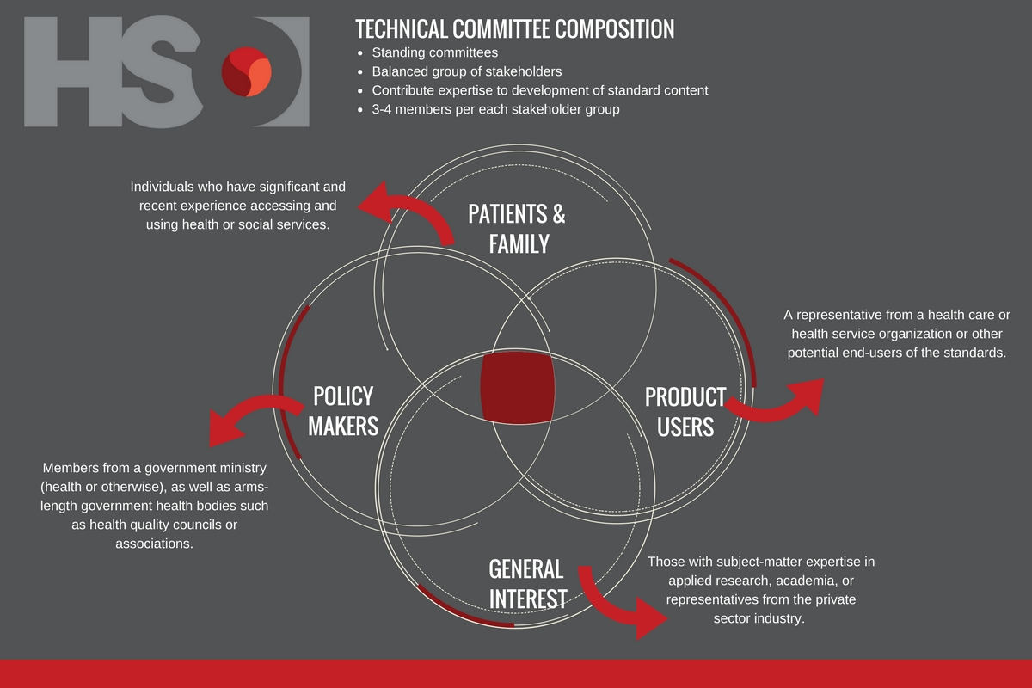
Notes:
Technical Committees are recruited in advance to ensure balanced participation of 3-4 members from four different stakeholder groups:
Patients and family: Individuals who are currently, or in recent past have had experience accessing the health system.
Product users/potential product users: A representative from a healthcare organization or other potential end-users of the standards.
Government/healthcare stakeholder/policy maker: Members from a government ministry (health or otherwise), as well as pseudo government bodies such as health quality councils or associations.
General interest: Those with subject-matter expertise in applied research, academia, or representatives from the private-sector industry.
Purpose is to provide expertise & guidance during the revisions of the standard
Representation from clients and family members, product users, stakeholders, and general interest
Global participation
Participation in 1 in-person meeting, and at least 2 teleconferences
Voting on content
Each of TC members brings the perspective of a specific group of key stakeholders
Member term is for 2-3 years and can be renewed
Committee is chaired by Program Manager and Technical Committee member
Solutions- standard development is not the only objective of the TC. Solutions can include other types of publications, identifying new areas for standards development or other projects, identifying sponsorship opportunities- TC members take an active leadership role.

Slide 17
TECHNICAL COMMITTEE RESPONSIBILITIES
Oversee development of standards
Guidance on emerging areas, new developments and trends
Leadership role regarding new opportunities for standards development
Identifying sponsorship and endorsement opportunities
Standards-related interpretation questions and technical content requests
Leading Practices
Notes:
To oversee the development of standard(s) related to the subject matter under the Committee’s purview.
To monitor, identify, and provide strategic guidance to Health Standards Organization (“HSO”) on emerging areas of importance within the scope of the Technical Committee. This may include, but is not limited to, proposing project proposals for the development of new standards.
To provide information on new developments and trends related to the subject matter area
To evaluate and approve Leading Practices submissions.
To provide guidance to HSO staff on standard(s) related interpretation questions and inquiries related to technical content of the standard(s)
Identifying sponsorship and endorsement opportunities
TCs will be responsible for:
The development of standards related to the subject matter under the Committee’s purview, including oversight of the relevant Working Groups.
Monitoring, identifying, and providing strategic guidance to HSO on emerging areas of importance. This may include, but is not limited to, initiating project proposals for the development of new standards.
Identifying affected stakeholders, potential users and key opinion leaders.
Aiding HSO staff in questions from standard users on interpretation of requirements/criteria.
Responding to requests for speaking engagements that HSO will receive on the standard(s) portfolio of the Technical Committee.
Contributing to standards activation by identifying implementation practices to assist users in implementing requirements/criteria.
Providing oversight (review and approval) of Leading Practices in the relevant field.

Slide 18
Standard Development Principles and Process

Slide 19










STANDARD DEVELOPMENT PRINCIPLES
Notes:
The standards respond to a need: HSO responds to a need or request from industry or other stakeholders such as end users.
The standards make health care human: The standards are centred on the needs of patients and families and foster compassion, listening and respectful communication.
The standards redirect healthcare efforts towards a better state: The standards are developed with the goal of improving health outcomes for patients, families and communities served.
The standards work across the system: The standards are built with all sectors of the health care system in mind and through assessment manuals, compliance assessment of the standards is scalable to the needs of large, small, simple or complex organizations.
The standards demonstrate Canadian relevancy and pertinence to other jurisdictions, as appropriate: The standards respond to strategic health and patient safety needs in the marketplace. They address strategic needs of stakeholders including language requirements, type of standard, decisions to revise standards, and needs due to geographical spread and location. Research is done to address emerging health and patient safety findings and to confirm needs by engaging affected stakeholders, be it Authorities Having Jurisdiction (AHJ), product users and/or patients and families. This information is used to inform decisions regarding maintenance of standards, decisions to support accreditation/certification programs, and to transition users to a different standard set.
The standards are evidence-informed and undergo regular review: The standards are based on the consolidation of evidence, experience, technology (when applicable), and focus on optimal system-level (community) benefit. The standards development process promotes continuous improvement through regular maintenance cycles ensuring that the content is reflective of current and up-to-date research findings.
The standards are global in content, local in implementation: The standards draw upon best practices internationally, but recognize the country or regional conditions and contexts that can impact how the standards are implemented.
The standards are developed with balanced interest in mind: HSO standards development is led by a Technical Committee, consisting of representatives from key stakeholder groups relative to the standards under review, and include: patients and families; product users; governments/policy makers; and others with general interest including academics. This principle ensures that all voices are heard and have value. The standards incorporate public feedback and notify affected stakeholders of any impacting changes.
The standards follow an open and transparent process: Both the public, affected stakeholders and other SDOs are notified and provided the opportunity to comment on HSO’s proposed Work Program. Interested parties are provided with open access to the standards development process.
People have equal access to participating in the standards development process by submitting comments or requests for new standards/new editions, joining a Technical Committee or Working Group, and by taking part in the public review of standards. HSO is committed to providing services in a way that respects the dignity and independence of persons with disabilities and that people with disabilities have the same opportunity to access and benefit from participating in the standards development. Appropriate accommodations shall be made to support Technical Committee or Working group members, in accordance with applicable legislation. HSO headquarters is in the province of Ontario and abides by the Accessibility for Ontarians with Disabilities Act (AODA), 2005, S.O. 2005, c.11.
The standards follow a clear and rigorous development process: The standards are developed in stages based on the International Harmonized Stage Codes and follow a well-documented, open and transparent process. Policies, procedures, and guidelines that relate to the standards development process are both clear and prescriptive to help avoid confusion.

Slide 20
STANDARD DEVELOPMENT PRINCIPLES
The standards respond to a need
Notes:
The standards respond to a need: HSO responds to a need or request from industry or other stakeholders such as end users.

Slide 21
STANDARD DEVELOPMENT PRINCIPLES
The standards make health care human
Notes:
The standards make health care human: The standards are centred on the needs of patients and families and foster compassion, listening and respectful communication.

Slide 22
STANDARD DEVELOPMENT PRINCIPLES
The standards redirect health care efforts towards a better state
Notes:
The standards redirect healthcare efforts towards a better state: The standards are developed with the goal of improving health outcomes for patients, families and communities served.

Slide 23
STANDARD DEVELOPMENT PRINCIPLES
The standards work across the system
Notes:
The standards work across the system: The standards are built with all sectors of the health care system in mind and through assessment manuals, compliance assessment of the standards is scalable to the needs of large, small, simple or complex organizations.

Slide 24
STANDARD DEVELOPMENT PRINCIPLES
The standards demonstrate relevancy and pertinence to the jurisdictions where it applies
Notes:
The standards demonstrate Canadian relevancy and pertinence to other jurisdictions, as appropriate: The standards respond to strategic health and patient safety needs in the marketplace. They address strategic needs of stakeholders including language requirements, type of standard, decisions to revise standards, and needs due to geographical spread and location. Research is done to address emerging health and patient safety findings and to confirm needs by engaging affected stakeholders, be it Authorities Having Jurisdiction (AHJ), product users and/or patients and families. This information is used to inform decisions regarding maintenance of standards, decisions to support accreditation/certification programs, and to transition users to a different standard set.

Slide 25
STANDARD DEVELOPMENT PRINCIPLES
The standards are global in content, local in implementation
Notes:
The standards are global in content, local in implementation: The standards draw upon best practices internationally, but recognize the country or regional conditions and contexts that can impact how the standards are implemented.

Slide 26
STANDARD DEVELOPMENT PRINCIPLES
The standards are developed with balanced interest in mind
Notes:
The standards are developed with balanced interest in mind: HSO standards development is led by a Technical Committee, consisting of representatives from key stakeholder groups relative to the standards under review, and include: patients and families; product users; governments/policy makers; and others with general interest including academics. This principle ensures that all voices are heard and have value. The standards incorporate public feedback and notify affected stakeholders of any impacting changes.

Slide 27
STANDARD DEVELOPMENT PRINCIPLES
The standards follow an open and transparent process
Notes:
The standards follow an open and transparent process: Both the public, affected stakeholders and other SDOs are notified and provided the opportunity to comment on HSO’s proposed Work Program. Interested parties are provided with open access to the standards development process.
People have equal access to participating in the standards development process by submitting comments or requests for new standards/new editions, joining a Technical Committee or Working Group, and by taking part in the public review of standards. HSO is committed to providing services in a way that respects the dignity and independence of persons with disabilities and that people with disabilities have the same opportunity to access and benefit from participating in the standards development. Appropriate accommodations shall be made to support Technical Committee or Working group members, in accordance with applicable legislation. HSO headquarters is in the province of Ontario and abides by the Accessibility for Ontarians with Disabilities Act (AODA), 2005, S.O. 2005, c.11.

Slide 28
STANDARD DEVELOPMENT PRINCIPLES
The standards follow a clear and rigorous development process
Notes:
The standards follow a clear and rigorous development process: The standards are developed in stages based on the International Harmonized Stage Codes and follow a well-documented, open and transparent process. Policies, procedures, and guidelines that relate to the standards development process are both clear and prescriptive to help avoid confusion.

Slide 29
STANDARD DEVELOPMENT PRINCIPLES
The standards are evidence- informed and undergo regular review
Notes:
The standards are evidence-informed and undergo regular review: The standards are based on the consolidation of evidence, experience, technology (when applicable), and focus on optimal system-level (community) benefit. The standards development process promotes continuous improvement through regular maintenance cycles ensuring that the content is reflective of current and up-to-date research findings.

Slide 30
STANDARD DEVELOPMENT PRINCIPLES
Notes:
The standards respond to a need: HSO responds to a need or request from industry or other stakeholders such as end users.
The standards make health care human: The standards are centred on the needs of patients and families and foster compassion, listening and respectful communication.
The standards redirect healthcare efforts towards a better state: The standards are developed with the goal of improving health outcomes for patients, families and communities served.
The standards work across the system: The standards are built with all sectors of the health care system in mind and through assessment manuals, compliance assessment of the standards is scalable to the needs of large, small, simple or complex organizations.
The standards demonstrate Canadian relevancy and pertinence to other jurisdictions, as appropriate: The standards respond to strategic health and patient safety needs in the marketplace. They address strategic needs of stakeholders including language requirements, type of standard, decisions to revise standards, and needs due to geographical spread and location. Research is done to address emerging health and patient safety findings and to confirm needs by engaging affected stakeholders, be it Authorities Having Jurisdiction (AHJ), product users and/or patients and families. This information is used to inform decisions regarding maintenance of standards, decisions to support accreditation/certification programs, and to transition users to a different standard set.
The standards are evidence-informed and undergo regular review: The standards are based on the consolidation of evidence, experience, technology (when applicable), and focus on optimal system-level (community) benefit. The standards development process promotes continuous improvement through regular maintenance cycles ensuring that the content is reflective of current and up-to-date research findings.
The standards are global in content, local in implementation: The standards draw upon best practices internationally, but recognize the country or regional conditions and contexts that can impact how the standards are implemented.
The standards are developed with balanced interest in mind: HSO standards development is led by a Technical Committee, consisting of representatives from key stakeholder groups relative to the standards under review, and include: patients and families; product users; governments/policy makers; and others with general interest including academics. This principle ensures that all voices are heard and have value. The standards incorporate public feedback and notify affected stakeholders of any impacting changes.
The standards follow an open and transparent process: Both the public, affected stakeholders and other SDOs are notified and provided the opportunity to comment on HSO’s proposed Work Program. Interested parties are provided with open access to the standards development process.
People have equal access to participating in the standards development process by submitting comments or requests for new standards/new editions, joining a Technical Committee or Working Group, and by taking part in the public review of standards. HSO is committed to providing services in a way that respects the dignity and independence of persons with disabilities and that people with disabilities have the same opportunity to access and benefit from participating in the standards development. Appropriate accommodations shall be made to support Technical Committee or Working group members, in accordance with applicable legislation. HSO headquarters is in the province of Ontario and abides by the Accessibility for Ontarians with Disabilities Act (AODA), 2005, S.O. 2005, c.11.
The standards follow a clear and rigorous development process: The standards are developed in stages based on the International Harmonized Stage Codes and follow a well-documented, open and transparent process. Policies, procedures, and guidelines that relate to the standards development process are both clear and prescriptive to help avoid confusion.

Slide 31
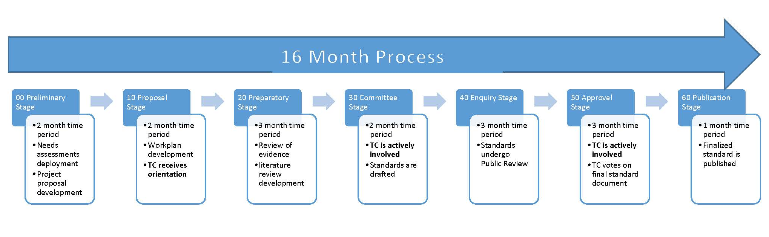
STANDARDS DEVELOPMENT PROCESS
Notes:
The standards development process is a 16-month process where Technical Committee members are actively engaged during the 30 Committee Stage when the TC drafts the standard’s technical content and during the 50 Approval Stage when the TC votes on the final version of the standard document.
TC voting process

Slide 32
STANDARD MAINTENANCE
Purpose: keeping standards current and technically relevant
Based on the standard’s subject matter area and on business need
Type of maintenance is established in initial stage of standard development
Continuous Maintenance
Standards on subject matter area with frequent new developments
Frequency of review is at least every four years
Periodic Maintenance
Standards on subject matter area with occasional new developments
Frequency of review has to be established in Stage 00 but at least every five years
Notes:
All HSO standards undergo regular maintenance in response to latest research findings and stakeholder needs. Depending on the scope and nature of the standard, the TC shall determine at the 00-Preliminary stage, whether the standard shall undergo periodic or continuous maintenance.

Slide 33
Standards Licensees

Slide 34
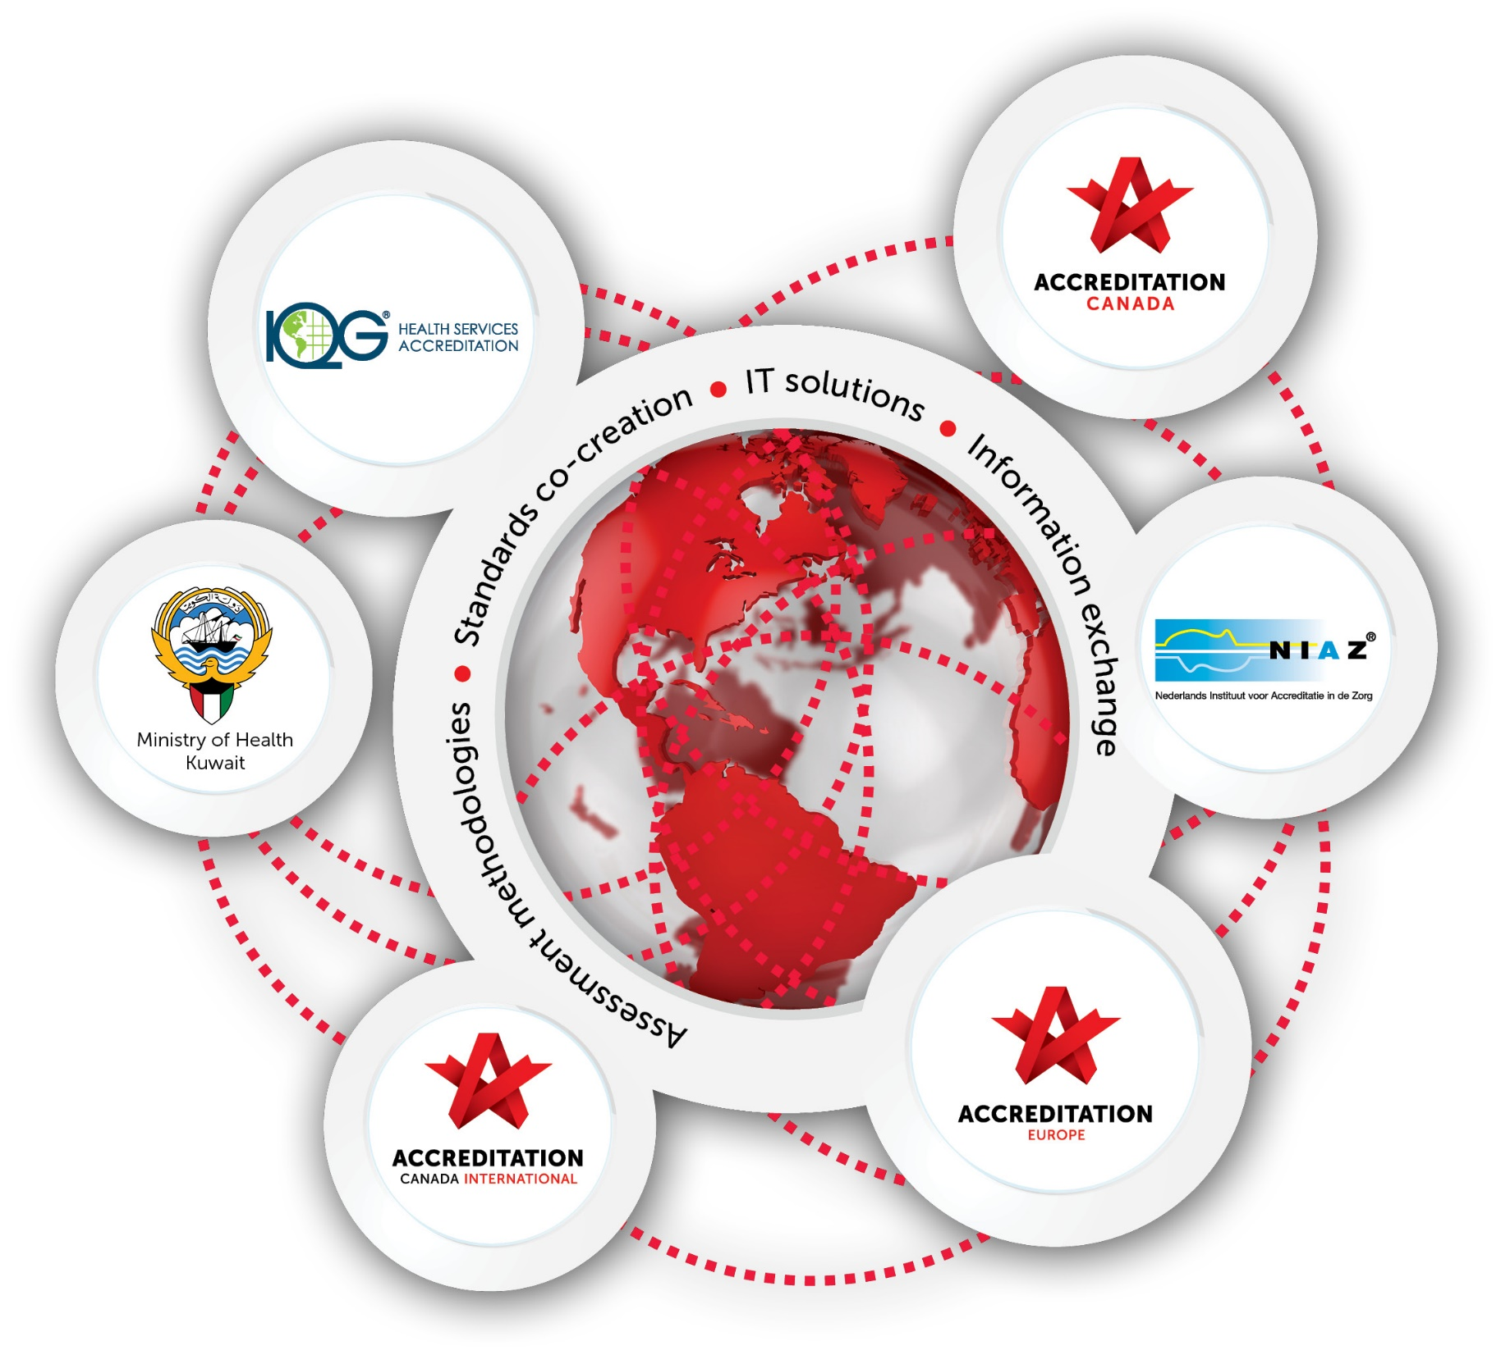
STANDARD LICENSEES

Slide 35
Thank you!

